Slide 1
Breast Cancer
AWARENESS
A Project of Probabibility And Statistics

Slide 2
Table of Contents
1
2
3
Introduction
Causes & affects
Objectives
4
5
6
Data Processing
Model Training
Results and Insights

Slide 3
1
Introduction
Breast Cancer
PRESENTED BY: ZOYA AZAD

Slide 4
Breast cancer is a tumor that originates in the cells of the breast. It occurs when breast cells grow uncontrollably, forming a mass of tissue. This cancer can spread (metastasize) to other parts of the body through the lymphatic system and bloodstream.

Slide 5
Breast Cancer Statistics (2020-2023):
2020
2021
2022
2023
685,000 deaths from breast cancer occurred in 2020.
Estimated 2.1 million new cases globally
Breast cancer was
the most common cancer in women in 157 countries out of 185 in 2022.
Estimated 2.7 million new cases worldwide.

Slide 6
2
DETECTION & DIAGNOSIS

Slide 7
How to detect breast cancer?
Mammography:
Biopsy:
Ultrasound Imaging:
Self-Examination:
(MRI):
Blood Tests:
A primary screening tool that detects early-stage breast cancer using low-dose X-ray imaging.
The most definitive method for diagnosis, involving the removal of tissue from a suspicious area for microscopic analysis.
Differentiates between solid tumors and benign cysts, especially useful when mammography results are inconclusive.
A simple, proactive approach to identify unusual lumps or
changes in breast tissue.
Provides detailed imaging, particularly beneficial for high-risk individuals or those with dense breast tissue.
While not diagnostic for cancer, certain biomarkers and general blood work may support the evaluation of a patient's health status.

Slide 8
Audience Demographics
GENDER
AGE
99%
Female
1%
Male
<18
18-45
>45

Slide 9
3
OBJECTIVES
PRESENTED BY: AROOBA

Slide 10
Objectives
1
2
3
Developing a machine learning application
Undersampling
Feature Analysis
4
5
Interactive Tool Creation
User Interactive Application

Slide 11
4
DATA PROCESSING
PRESENTED BY: AROOBA

Slide 12
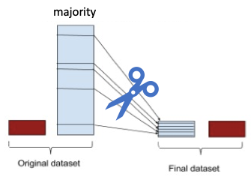
What Sampling methodAre We Going to use?
Random Undersampling:
The RandomUnderSampler from the imblearn library is used to balance the dataset by reducing the samples of the majority class (Benign) to match the minority class (Malignant).
Reason for Use:
The dataset has more Benign cases than Malignant, which could bias the model. Undersampling ensures equal representation, improving the model's accuracy for both classes.

Slide 13
Steps
Loading the Dataset
Handling Class Imbalance
Feature Encoding
Feature Scaling

Slide 14
5
MODEL TRAINING
PRESENTED BY: AROOBA

Slide 15
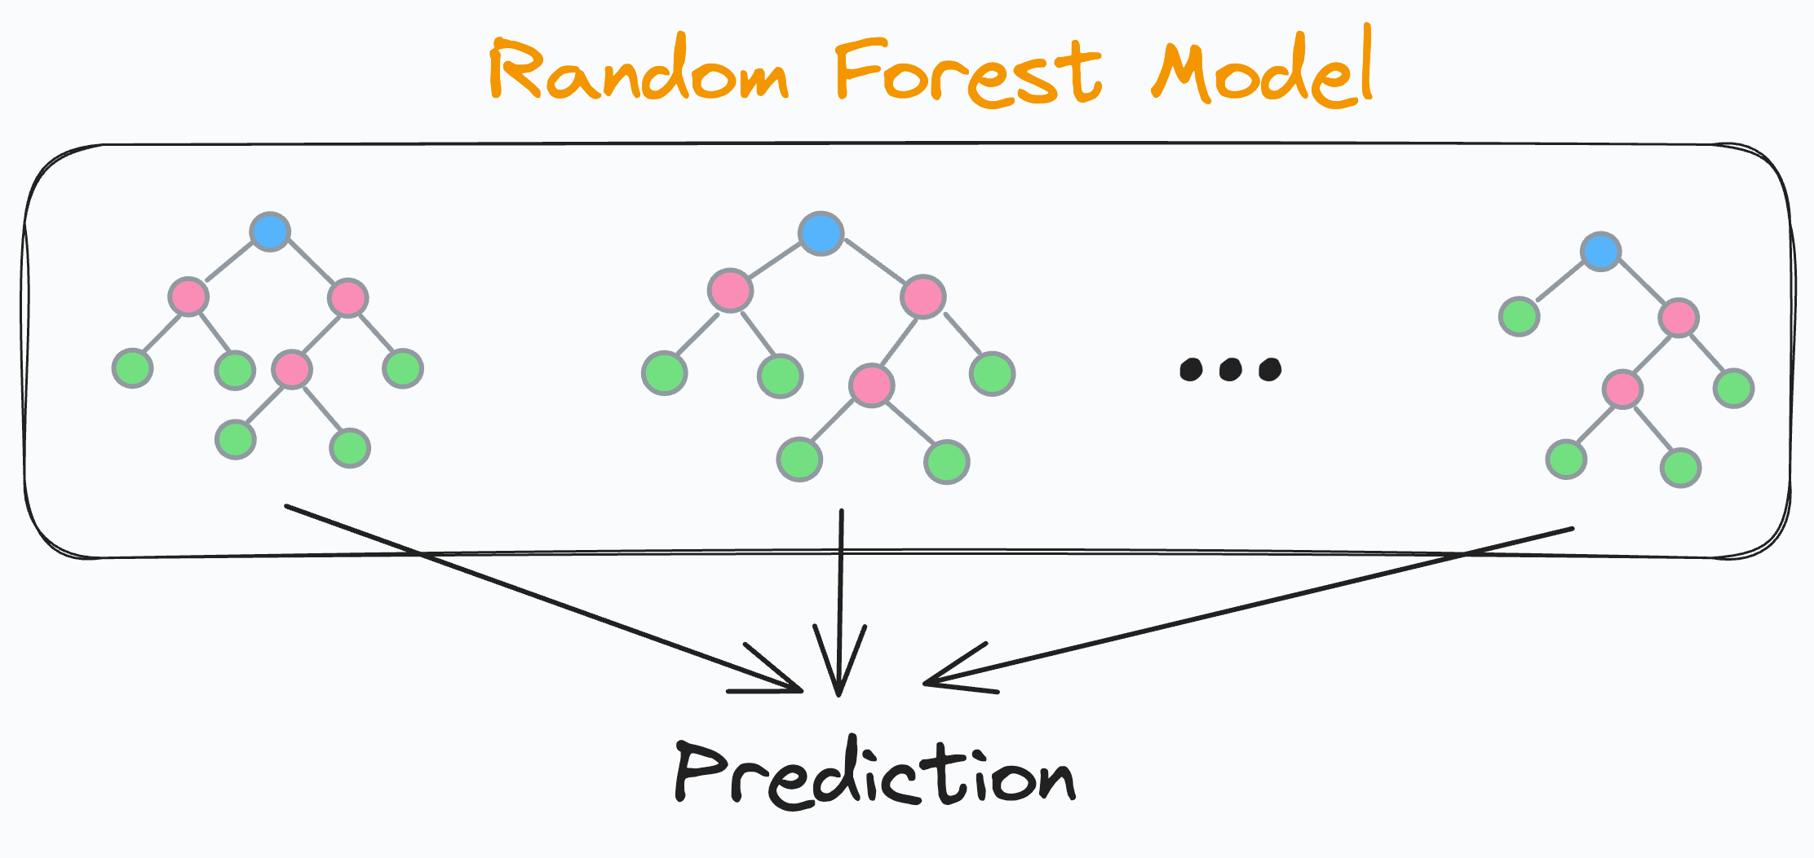
Which Model Are We GoingTo Use
Model Used: We used the Random Forest Classifier, which combines multiple decision trees to make accurate predictions. It is robust and handles complex datasets effectively, making it ideal for breast cancer classification.
Why We Chose It: Random Forest handles imbalanced data well and provides insights into key features influencing predictions. Its high accuracy and reliability make it suitable for cancer diagnosis applications.

Slide 16
Steps
Splitting
After undersampling, we split the balanced dataset into training (70%) and testing (30%) sets.
Training the Model:
A Random Forest Classifier with 100 decision trees was trained on the processed data.
Prediction Tool:
A Streamlit app was created to allow users to input values for tumor features and predict the likelihood of cancer being benign or malignant.
Feature Importance Visualization:
The model identified the most critical features influencing predictions, such as perimeter_mean and concavity_mean.

Slide 17
6
RESULTS AND INSIGHTS
PRESENTED BY: AROOBA

Slide 18
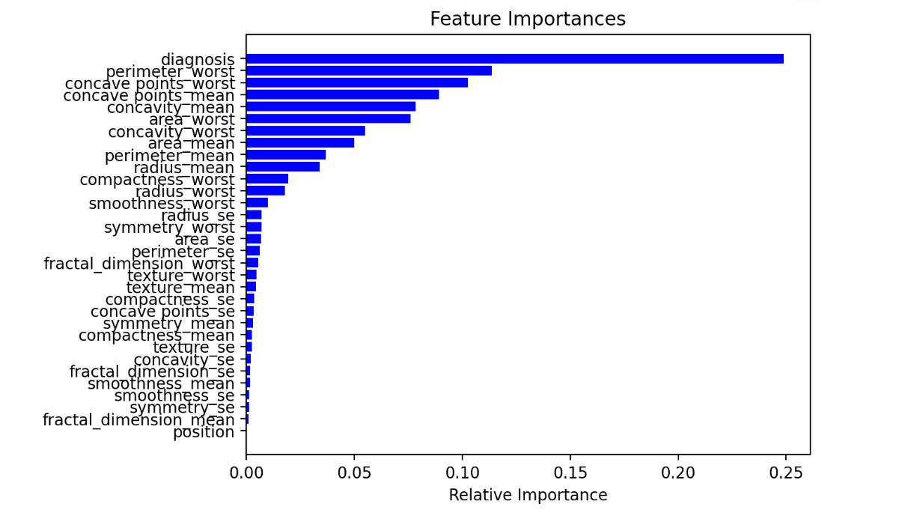

Slide 19
7
DEMO OF PROJECT
PRESENTED BY: AROOBA

Slide 20
Thanks!
Any questions?

